Slide 1
Digital Portfolio
STUDENT NAME: SOWNTHAR R
REGISTER NO AND NMID: 2422K2766
DEPARTMENT: BSc computer science
COLLEGE: COLLEGE/ UNIVERSITY GOVT ARTS AND SCIENCE COLLEGE KANGEYAM , BHARATHIYAR UNIVERSITY

Slide 2
PROJECT TITLE
PORTFOLIO

Slide 3


AGENDA
Problem Statement
Project Overview
End Users
Tools and Technologies
Portfolio design and Layout
Features and Functionality
Results and Screenshots
Conclusion
Github Link
3/21/2024 Annual Review

Slide 4

PROBLEM STATEMENT
Current issue: Many students struggle with understanding how data structures work.
Why it matters. Without strong basics, coding becomes harder
Who faces it Computer science students, beginners in programming.
Goal Create a project that shows data structures visually to make leaming easier.

Slide 5

PROJECT OVERVIEW
1. project Title - Name of your project
2. Objective-What the project aims to achieve.
3. Technology Used-Languages, tools, or frameworks applied.
Key Features-Main functions or highlights of the project.
5. Target Users-Who will benefit from it.
6. Outcome-What the project delivers/solves.

Slide 6

WHO ARE THE END USERS?
1.Computer Science Students-who are leaming data structures for the first time.
2. Beginner Programmers-who want to understand coding logic better.
Teachers/Instructors-who can use it as a teaching aid.
4. Software Developers (Entry Level) - who need to revise basic concepts quickly.
5. Anyone Preparing for interviews-since data structures are important in technical rounds.

Slide 7

TOOLS AND TECHNIQUES
Tools
Languages: C. C++, Java
Software: Visual Studio Code (or any code editor)
GitHub: To store and share code
MS PowerPoint/Docs: For project report
Techniques
Breaking work into small parts (modular programming)Using classes and objects (OOP in C++/Java)Applying data structures like stack, queue, linked list, treeWriting step-by-step algorithms to solve problemsMaking it easy to understand (visual/clear explanation)

Slide 8
POTFOLIO DESIGN AND LAYOUT
1. Header Section-Shows your name (K. Bharani) and navigation menu (About. Skilis, Projects, Contact)
2. About Section-Short description about you (focus on Data Structures).
3. Skills Section-List of your skills (C. C++, Java, Data Structures)
4 Projects Section Cards/boxes to show your projects with title + description
5. Contact Section-Email, phone number, or links.
6. Footer-Copyright note (e.g. 2025 K. Bharanij
8

Slide 9
FEATURES AND FUNCTIONALITY
1. Clean Design-Simple and easy-to-read layout
2. Navigation Menu-Quick links to About, Skills, Projects, Contact.
3. About Section-Short introduction about you.
4. Skills Section-Displays your programming skills (C, C++, Java, Data Structures).
5. Projects Section-Highlights your project with title and description.
6. Contact Section Shows your email and phone number.
7. Responsive Design Works on computer and mobile screens.

Slide 10
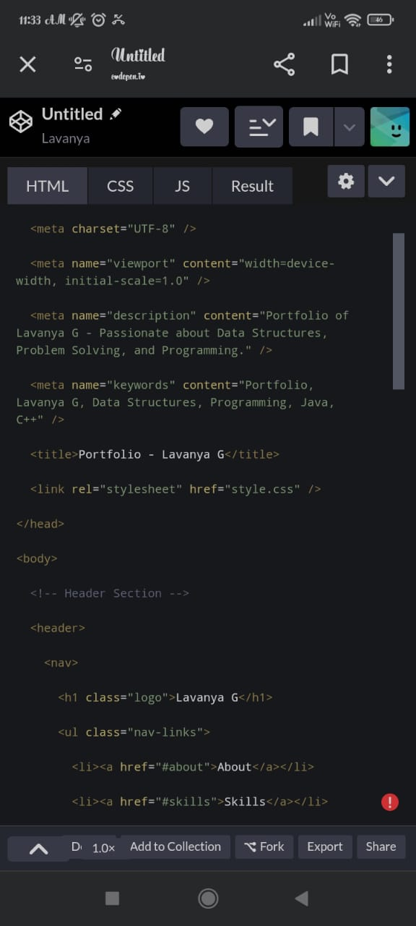
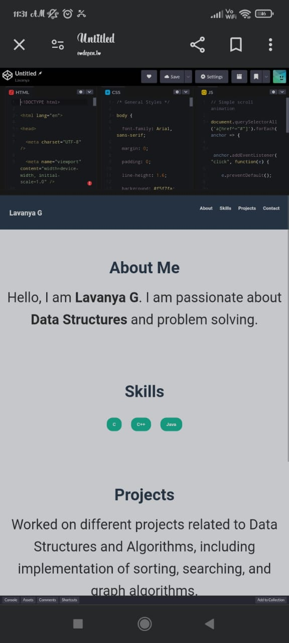

RESULTS AND SCREENSHOTS
3/21/2024 Annual Review
10

Slide 11
CONCLUSION
This portfolio gives a clear view of who I am and what I can do.
It shows my skills in C, C++, Java, and Data Structures.
My project highlights how I can apply my knowledge to salve real problems.
The portfolio is simple, user-friendly, and easy to navigate
It helps others (Seachers, recruiters, friends) understand my work quickly.
11

